Slide 1
Distributed Pattern Matching: A Key to Flexible and Efficient P2P Search Reaz Ahmed and Raouf Boutaba IEEE JOURNAL ON SELECTED AREAS IN COMMUNICATIONS, VOL. 25, NO. 1, JANUARY 2007
學生：王詩媛
2008/06/12

Slide 2
Outline
Introduction
Related Works
Distributed Pattern Matching System (DPMS)
Analysis
Experimental Evaluation
Conclusion

Slide 3
Introduction
Flexibility and efficiency are the prime requirem-ents for any P2P search mechanism.
Unstructured search protocols (as adopted in Gnutella and FastTrack) provide search flexibility but exhibit poor performance characteristics.
Structured search techniques (mostly Distribu-ted Hash Table (DHT)-based) can efficiently route queries but support exact-match semantic only.

Slide 4
Introduction
DPMS(Distributed Pattern Matching System) achieves many desirable properties of both the unst-ructured and structured P2P systems.
Like unstructured systems, DPMS supports partial keyword matching, utilizes the heterogeneity in peer capabilities, and does not place any hard restriction on index/document placement.
Like structured systems, DPMS attains logarithmic bound on search complexity and offers guarantee on search completeness and discovery of rare items.
Notes:
Problems that can be mapped to DPM include
Partialand multi-keyword search for content sharing P2P systems
partial service description matching for service discovery systems
data record pre-scanning for distributed P2P database systems
molecular fingerprint matching in some envisioned distributed environment, etc.

Slide 5
Introduction
We have defined Distributed Pattern Matching (DPM) as a variant of the generic pattern match-ing problem with two additional constraints.
First, we are interested in Bloom filter based pattern matching (i.e., subset matching).
Second, we assume that the patterns are scattered among the peers of a P2P overlay .

Slide 6
Introduction
In DPMS(Distributed Pattern Matching Syste-m), advertised patterns are replicated and aggregat-ed by the peers, organized in a lattice-like hierarchy.
Replication improves availability and resilience to peer failure, and aggregation reduces storage overhead.

Slide 7
Related Works
From architectural point of view, Secure Service Dis-covery Service (SSDS) is the closest match to DPMS.
 | Like | unlike
 |  | index distribution | replication
SSDS | Bloom filter and aggregation | tree-like hierarchy | not use any replication in the indexing hierarchy
DPMS |  | lattice-like hierarchy | use replication in the indexing hierarchy

Slide 8
Related Works
From architectural point of view, Secure Service Dis-covery Service (SSDS) is the closest match to DPMS.
 | unlike
 | aggregation mechanism
SSDS | bitwise logical-OR for index aggregation
DPMS | retains unchanged bits from constituent patterns and provides useful information for query routing

Slide 9
Related Works
Bloom filter is used by many unstructured P2P systems for improving query routing performan-ce.
In [14] each peer stores Bloom filters from peers one or two hops away. Experimental results sho-w that logical OR-based aggregation of Bloom fi-lters is not suitable for aggregating information from peers more than one hop away.

Slide 10
Related Works
In [15] each peer store a list of Bloom filters per neighbor. A query is forwarded to the neighbor with a matching Bloom filter at the smallest hop-distance.
This approach aims to find the closest replica of a document with a high probability.

Slide 11
Related Works
DHT-technique for solving partial keywo-rd matching
Squid supports partial prefix matching (e.g., queries like compu* or net*) and multi keyword queries.
A keyword can be fragmented into η-grams, and each η-gram can be hashed and stored at the responsible peer.

Slide 12
Distributed Pattern Matching System (DPMS)
A. Overview
We will use the terms pattern and index interchan-geably, as patterns are used as indices for query routing.
In DPMS a peer can act as a leaf peer or indexing peer.

Slide 13
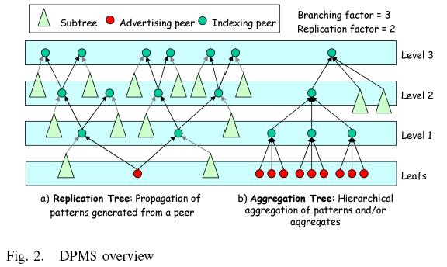
Distributed Pattern Matching System (DPMS)

Slide 14
Distributed Pattern Matching System (DPMS)
A. Overview
Replication strategy would generate a large volume of advertisement traffic. To overcome this shortcoming, DPMS combines replication with lossy-aggregation. (Fig. 2a)
Advertisements from different peers are aggregated and propagated to peers in the next level along the aggregation tree . (Fig. 2b)

Slide 15
Distributed Pattern Matching System (DPMS)
A. Overview
The structure of the indexing hierarchy and the am-ount of replication are controlled by two system-wide parameters, namely replication factor R and branching factor B.
Patterns advertised by a leaf peer are propagated to R^{l} indexing peers at level l.
On the other hand, an indexing peer at level l contains patterns from B^{l} leaf peers.

Slide 16
Distributed Pattern Matching System (DPMS)
R^{l}
R^{l}
B^{l}

Slide 17
Distributed Pattern Matching System (DPMS)
A. Overview
The indexing hierarchy has three-fold impact on system performance.
Firstly, the indexing hierarchy evenly distribute-s index information (and queries) in the highest level indexing peers. This helps in load balancing the system and imp-roves fault tolerance.

Slide 18
Distributed Pattern Matching System (DPMS)
A. Overview
Secondly, peers can route queries towards a target leaf peer without having any global knowl-edge of the overlay topology.
Finally, the indexing hierarchy helps in minimiz-ing query forwarding traffic.

Slide 19
Distributed Pattern Matching System (DPMS)
B. Index/pattern Construction
DPMS uses Bloom filters as indices.
Bloom filter is a space-efficient data structure used for set membership tests.
However, this space-efficiency comes at the expense of a small possibility of false positive in the membership check operation.

Slide 20

Distributed Pattern Matching System (DPMS)
下面我們具體來看Bloom Filter是如何用位元陣列表示集合的。初始狀態時，Bloom Filter是一個包含m位元的位元陣列，每一位元都置為0。

Slide 21

Distributed Pattern Matching System (DPMS)
為了表達S={x₁, x₂,…,x_{n}}這樣一個n個元素的集合，Bloom Filter使用k個相互獨立的雜湊函數（Hash Function），它們分別將集合中的每個元素映射到{1,…,m}的範圍中。對任意一個元素x，第i個雜湊函數映射的位置h_{i}(x)就會被置為1（1≤i≤k）。

Slide 22

Distributed Pattern Matching System (DPMS)
在判斷y是否屬於這個集合時，我們對y應用k次雜湊函數，如果所有h_{i}(y)的位置都是1（1≤i≤k），那麼我們就認為y是集合中的元素，否則就認為y不是集合中的元素。下圖中y₁就不是集合中的元素。y₂或者屬於這個集合，或者剛好是一個false positive。

Slide 23
Distributed Pattern Matching System (DPMS)
B. Index/pattern Construction
In DPMS all the keywords associated with a document are encoded in a single Bloom filter.
To facilitate wildcard matching, each keyword is first fragmented into η-grams (usually trigrams).
These η-grams are then inserted into the Bloom filter representing the document.

Slide 24
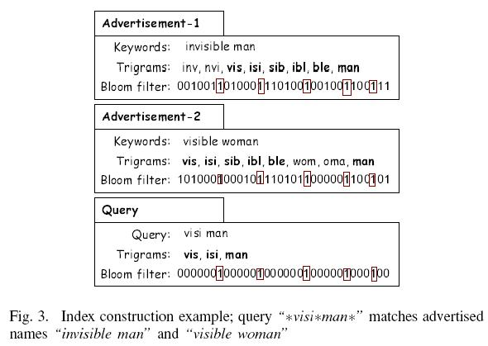
Distributed Pattern Matching System (DPMS)

Slide 25
Distributed Pattern Matching System (DPMS)
C. Aggregates
DPMS index distribution and query routing architecture is independent of the underlying aggregation scheme.
An aggregation mechanism should have the following properties to be compatible with the DPMS indexing hierarchy:

Slide 26
Distributed Pattern Matching System (DPMS)
C. Aggregates
1.The aggregation scheme should compress index information obtained from child peers. Lossy compression is allowed.
2.The aggregated form should retain original pattern information (to some extent), making it possible to perform pattern matching on the aggregates.
3.Repeated aggregation should be possible

Slide 27
Distributed Pattern Matching System (DPMS)
we suggest a don’t care based aggregation scheme; don’t cares (represented by X) are used at the positions where the constituent patterns (or aggregates) differ.

Slide 28

Distributed Pattern Matching System (DPMS)
We will use ⊗ to denote the aggregation operation. If Q = A⊗B, then the i^{th} bit of Q is obtained as,

Slide 29
Distributed Pattern Matching System (DPMS)
However incorporating this extra information (i.e., X’s) incur some space overhead, which can be minimized by compressing the aggregates using huffman coding or run length encoding during transmission through the network.

Slide 30
Distributed Pattern Matching System (DPMS)
D. Aggregation Process
An indexing peer acts as a multiplexer in the indexing hierarchy.
It gathers in-lists (lists of patterns or aggregates from the B child peers), aggregates them to another list (referred to as out-list) of aggregates, and sends this list to each of its parents.

Slide 31
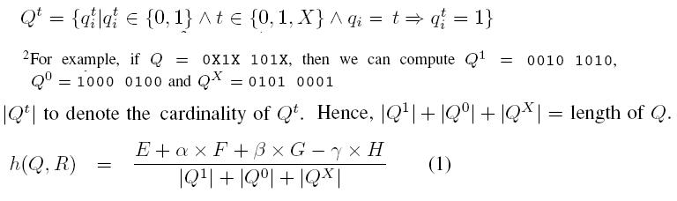
Distributed Pattern Matching System (DPMS)
The formula for measuring the similarity of two patterns/aggregates, say Q and R, is given in (1).

Slide 32
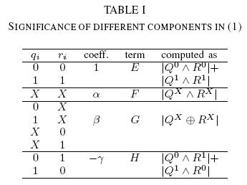
Distributed Pattern Matching System (DPMS)
Notes:
E and F define the number of positions in the aggregate that will remain the same as that of Q (or R).
While G and H give a measure of relative increase of X-bits in the resulting aggregate.
Coefficients α, β and γ depend on the nature of the patterns, which may require system specific tuning.

Slide 33
Distributed Pattern Matching System (DPMS)
In-list (Pattern[]) is an array of patterns or aggregates constructed from the B in-lists received from the B children.
Minimum non-X bits (O) is the minimum number of original (i.e., non-X) bits an aggregate must retain after aggregation.
Target aggregation ratio (A) is the ratio of the number of aggregates in the out-list to the number of patterns/ aggregates in the in-list. The aim is to achieve an aggregation ratio of A without violating the constraint imposed by O.

Slide 34
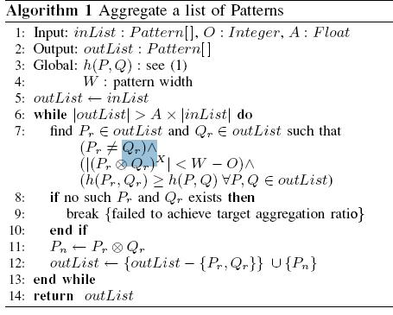
Distributed Pattern Matching System (DPMS)

Slide 35
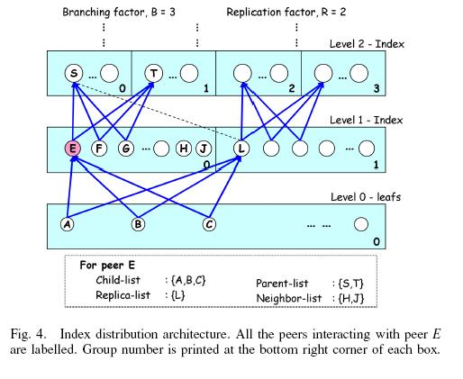
Distributed Pattern Matching System (DPMS)
E. Index Distribution
At level (l+1)and rang [g × R, (g + 1) × R)
at level l and group g (0 ≤ g < R^{l} )
Notes:
During the ascending phase, an initiating (or intermediate)
peer checks its local information for the existence of a match.
The blind search phase is executed by a highest level peer,
say Z, upon receiving a query (from a child) that does not
match any aggregate in its aggregate-lists. Z floods the query
to all other peers in its group.
A query enters into the descending phase when it hits a peer
containing a matching aggregate. The query is then forwarded
to the child peer advertising the matching aggregate. This
process recurs until the query reaches a leaf peer.

Slide 36
Distributed Pattern Matching System (DPMS)
F. Query Routing
A query can be initiated by any peer in the system.
The query life-cycle can be divided into three phases: ascending phase, blind search phase and descending phase.

Slide 37
Distributed Pattern Matching System (DPMS)
Two types of exceptions may occur.
Firstly, a false match may occur and the search branch terminates.
Secondly, a peer may have multiple children matching the query and multiple search branches can be initiated.
A possible scale for measuring the quality of a match is (|P1∧Q1|+|P0∧Q0|)/(|P0|+|P1|+|PX|), i.e., the proportion of exact-match of a query Q with an aggregate P.

Slide 38
Distributed Pattern Matching System (DPMS)
G. Topology Maintenance
In the DPMS index distribution hierarchy, peers interact with each other in different roles, e.g., parent, child, neighbor etc.
An indexing peer, say E, at level l and group g, maintains four separate lists for this purpose (see Fig. 4).

Slide 39
Distributed Pattern Matching System (DPMS)

Slide 40
Distributed Pattern Matching System (DPMS)
H. Arrival of Peers
To join as a leaf a peer, say C, has to find a level 1 indexing peer, say P, with an empty slot in its child-list.
C joins the indexing hierarchy as a child of P.
C constructs its parent-list using the replica-list of P, and starts advertising its patterns to all of its parents.
If C fails to find a level 1 peer with an empty slot then it can either join in both level 1 and level 0, or select a level 1 peer with smaller number of children.

Slide 41
Distributed Pattern Matching System (DPMS)
To join as an indexing peer, a peer, say E, has to go through the following steps:
Choose level and group: E has to choose a level, say l, in the hierarchy. Selection of level can be based on the nodes capacity, uptime distribution etc.
Construct child-list: A is at level (l−1) and in group g/R, and the parentlist of peer A contains less than R entries. E can join as a parent of A.

Slide 42
Distributed Pattern Matching System (DPMS)

Slide 43
Distributed Pattern Matching System (DPMS)
Construct parent-list: To construct parent-list, E has to find a peer, say T , such that T is in level (l +1) and in group (g × R), and T has an empty slot in its child-list.

Slide 44
Distributed Pattern Matching System (DPMS)
I. Departure/Failure of Peers
The absence of an indexing peer, say E, will affect the peers in its parent-list, child-list and replica-list.
Parents and children of E can still communicate through any of the replicas of E.
So query routing is not hampered until all of the replicas of a peer fail.

Slide 45
Distributed Pattern Matching System (DPMS)
Failure or departure of a leaf peer has greater impact on the system.
This will decrease search performance to some extent.

Slide 46
Distributed Pattern Matching System (DPMS)
To efficiently deal with frequent join and leave of a leaf peer, indexing peers should advertise their index information at constant intervals.
Any advertisement from a child peer should be delayed until the end of the interval.

Slide 47
Analysis
A. Query Routing Efficiency
we will provide an analytical bound on the levels of indexing hierarchy that will allow query routing in O(logN) hops.
N : the total number of peers in the system
B: branching factor
R: replication factor
n_{l} : the number of peers at level l.
h :Leaf peers reside at level 0 and the height (or maximum level) of the indexing hierarchy .

Slide 48
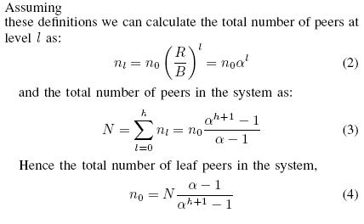
Analysis

Slide 49


Analysis

Slide 50


Analysis
Thus we claim that if we can build and maintain an indexing hierarchy of height
then we will be able to solve the DPM problem in time.
O(logN) : is the cost of flooding one of the R^{h} groups at level h

Slide 51

Analysis
: the cost of reaching the κ matching leaf peers along the indexing hierarchy of height
ξ :accounts for the lossy aggregation scheme.

Slide 52
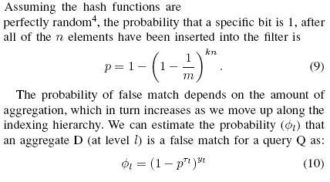
Analysis
B. False Match Probability

Slide 53
Analysis
yl :is the average number of patterns contained in D
τl = |Q¹ ∧ D^{X}|.
pτl :is the probability that all of the τl 1-bits of Q are present in a pattern contained in D,
φl :stands for the probability that none of the constituent patterns in D, has all of the τl 1-bits of Q.

Slide 54
Analysis
For bitwise-OR based aggregation scheme, we can estimate false match probability as,
ψ_{l} = (1 − p^{τ} )^{yl}

Slide 55
Analysis
C. An Estimate of ξ
Let ν be the probability that a query will fail to match any aggregate at level l, though it matched an aggregate at level (l +1).
Then a query will fail to match an aggregate at level l with probability (1 − ν)^{h−l}ν and in that case (h − l) hops will be wasted.

Slide 56


Analysis
the expected number of probes in a complete descending phase (i.e., from level h to level 0) is:

Slide 57


Analysis
D. Advertisement Overhead
the ratio of message count in these two systems is:
the ratio of message volume in these two systems is:

Slide 58
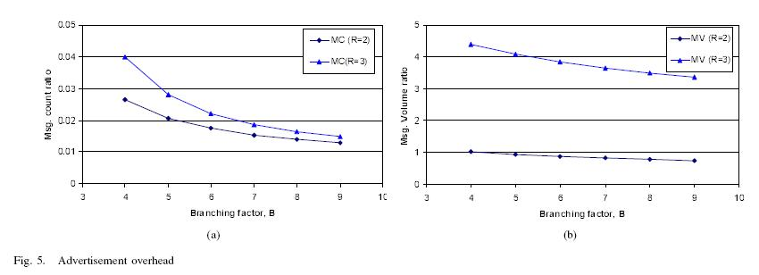
Analysis

Slide 59
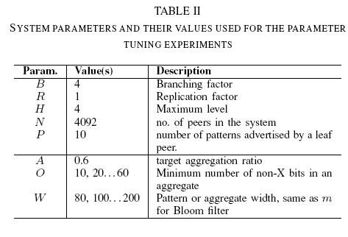
Experimental Evaluation

Slide 60
Experimental Evaluation
a) random case: patterns are randomly generated bit strings
b) biased case: patterns are Bloom filters generated using 3- grams from <song title, artist> tuples

Slide 61
Experimental Evaluation
A. Parameter Tuning
First-hit probes is the number of peers being probed before the first match is found.
Avg. probes/hit is the average number of probes required for each hit. In the cases where multiple matches were present, we traced up to 20 matches.

Slide 62

Experimental Evaluation
A. Parameter Tuning
Indexing overhead (IO) is an indicator for the extra storage space requirement introduced by the indexing hierarchy.

Slide 63

Experimental Evaluation
A. Parameter Tuning
Effectiveness of aggregation (EA) quantifies the amount of reduction in (index) storage requirement achieved with the aggregation mechanism, and is measured as:

Slide 64
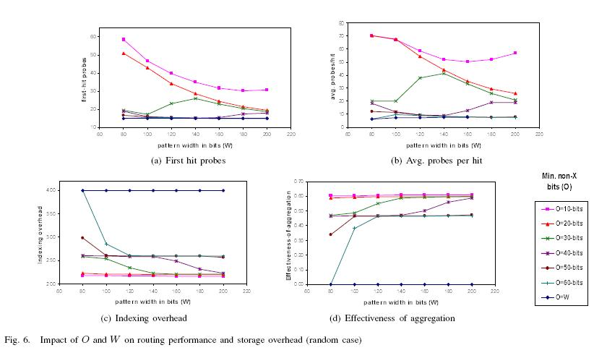
Experimental Evaluation
A. Parameter Tuning

Slide 65
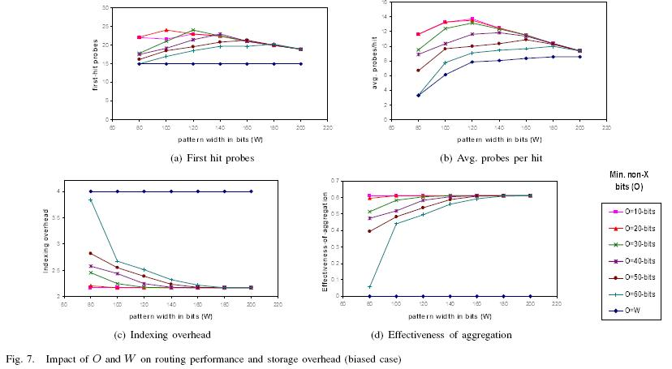
Experimental Evaluation
A. Parameter Tuning

Slide 66
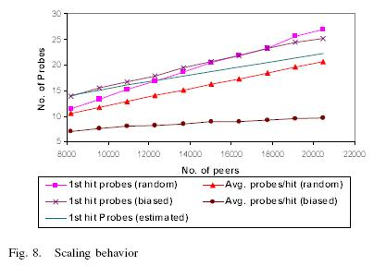
Experimental Evaluation
A. Parameter Tuning

Slide 67
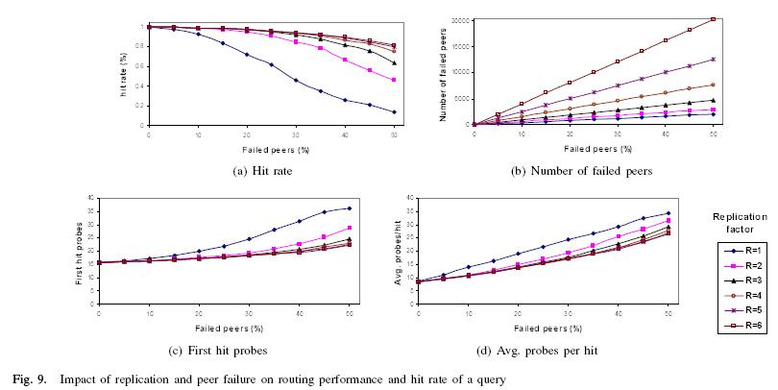
Experimental Evaluation

Slide 68
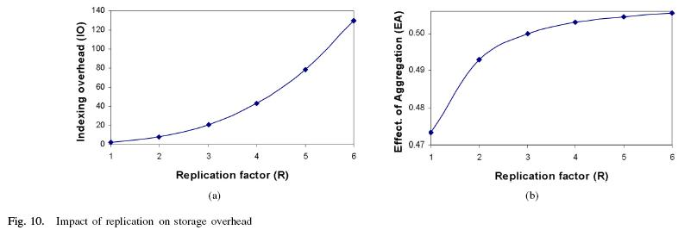
Experimental Evaluation

Slide 69
Conclusion
DPMS supports flexible queries involving partial and multiple keywords.
Query routing efficiency of DPMS is comparable to that of the structured P2P systems.
This problem of leave/join of leaf peers can be mitigated by using periodic and differential updates of index information between adjacent indexing peers.

Slide 70
Conclusion
Modification of data at leaf peers will invalidate the associated index information. It is possible to reduce the effect of data dynamism using periodic index updates.

